Slide 1
Foundation update
AP* meeting
APRICOT
Melbourne
February 2020

Slide 2
Contents
Board update
Project update
New funding proposals
Funding table

Slide 3
Board update
Prof. Jun Murai from Japan confirmed as the sixth Board member.
Joining:
Ms Sylvia Sumarlin (Chair) (Indonesia)
Mr. Michael Malone (Australia)
Mr Edward Suning Tian (China)
Mr Sharad Sanghi (India)
Dr. Jun Murai (Japan)
Mr Danish A. Lakhani (Pakistan)
Search continuing for seventh and final Board member
Notes:
From the last round, Jerry Yang did not accept

Slide 4
Project update (1)
Project: PNG training (2018-19-20) - ended
Donors: Asia Foundation (USA); DFAT (Australia); MFAT (New Zealand)
Economy: Papua New Guinea
Funding: USD 451,731. The largest single training and technical assistance investment in any APNIC economy.
Impact
21 community engagements including 18 training workshops, technical assistance and consultations.
383 participants received certificates of course completion.
PNGNOG and PNGCERT established
Notes:
The final amount coming directly to the APNIC Foundation is USD 343,323 – this is a revised amount, but there is no change to the overall project amount invested in PNG, .
The USD 214,677 to the Asia Foundation is used to fund cyber security activities and support APNIC participation
The project will continue in 2019, with more training workshops
Additional funding is likely to be offered

Slide 5
Project update (2)
Project: Pacific technical training (2019-20)
Donor: DFAT
Economies: Fiji, Solomons, Tonga and Vanuatu
Funding: USD 336,000
Community consultations held in Solomons, Tonga, Fiji and Vanuatu. Meetings held with every APNIC member.
Impact
Technical training and assistance in the Pacific

Slide 6
Project update (3)
Project: RPKI deployment support for IXPs (at APRICOT)
Donor: JPNIC
Economies: Bhutan, Myanmar and Nepal - with Fiji and Vanuatu accepting invitations (Nepal, India and PNG also invited but could not attend)
Funding: Full cost recovery
Impact
Accelerated RPKI deployment at IXPs

Slide 7
Project update (5)
ISIF Asia 2019 Network Operations Research Grants
Modelling and identifying IP address space fragmentation pressure points. Curtin University. Australia. USD 20,000
Honeynet Threat Sharing Platform. SGU, BSSN (Badan Siber & Sandi Negara) and Indonesia Honeynet Project (IHP). Indonesia. USD 20,000
Implementation and Utilities of RDAP for wider usability among Internet Stakeholders. University of Malaya. Malaysia. USD 20,000
Network coding over satellite links: scheduling redundancy for better goodput. The University of Auckland. New Zealand. USD 20,000

Slide 8
Project update (6)
ISIF Asia 2019 I4D Powering Internet Infrastructure Grants
Telemetering the telltale signs of power issues of wireless internet relays. Rural Broadband – AirJaldi. India. USD 20,000
Network Remote Powering through Quasi-Passive Optical Nodes. Royal Melbourne Institute of Technology. Australia. USD 20,000

Slide 9
Project update (4)
Project: Myanmar university network training (2019)
Donor: KDDI Foundation (Japan)
Economy: Myanmar
Funding: USD 29,144
Full cost recovery for APNIC for two workshops and two trainers

Slide 10
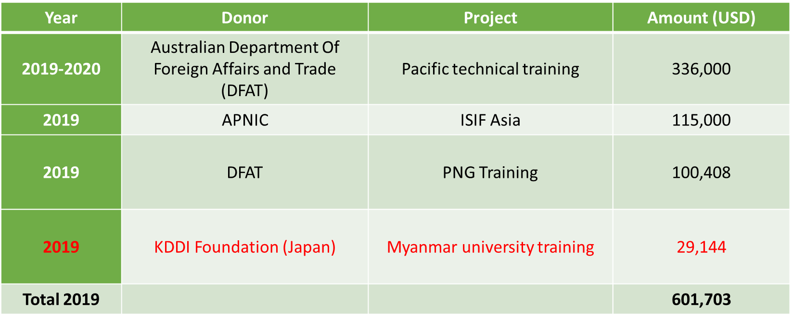
Funding to date*
* Funding in red is sent directly to APNIC

Slide 11
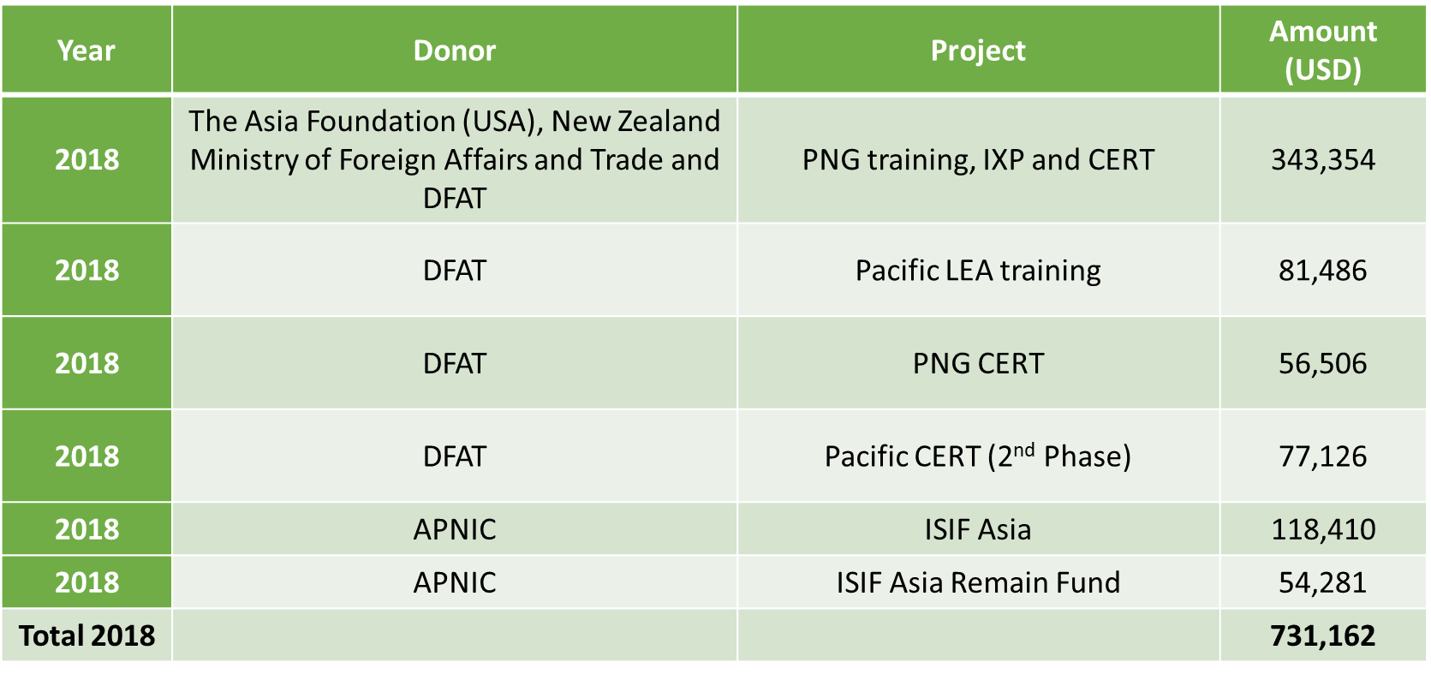
Funding to date

Slide 12
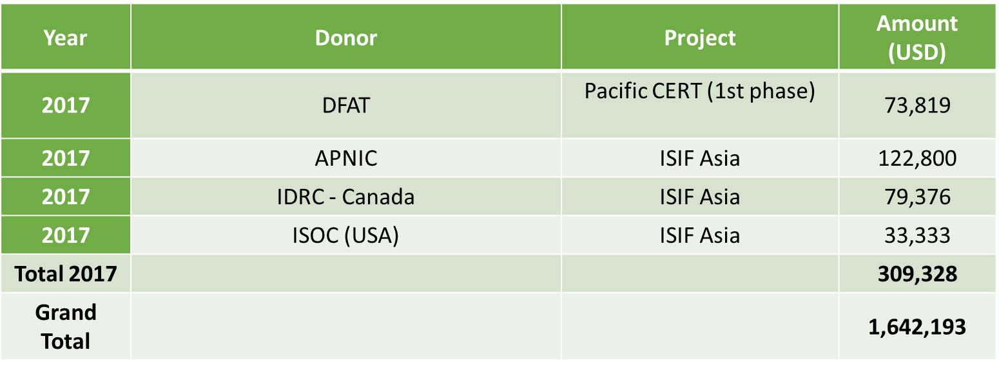
Funding to date

Slide 13
Thanks

